Slide 1

Implementation of 128-bit AES(Advanced Encryption Standard) algorithm using Verilog HDL(encryption part only)
Prepared By:
Pankaj Vishwakarma(19116046)
Shivam Kumar(19116070)
Vaibhav Anuragi(19116085)
Yash Raj(19116089)

Slide 2

Architecture of the Design:
The AES algorithm(encryption part) consists of two main process- Cypher and Key Expansion. Cipher converts data to an unintelligible form known as cipher text. Key expansion generates a key schedule that is used in Cipher.
The input of AES is a 128 bit block and is known as the matrix. This block is copied into a state array which is modified at each stage of the algorithm and then copied to the output matrix. Both the plaintext and key are depicted as a 128 bit square matrix of bytes. This key is then expanded into an array of key schedule words. The algorithm begins with an Add Round Key stage followed by 9 rounds of four stages and a tenth round of three stages.
The four stages are as follows:
Substitute bytes
Shift rows
Mix columns
Add round key
The tenth round simply leaves the Mix column stage.

Slide 3
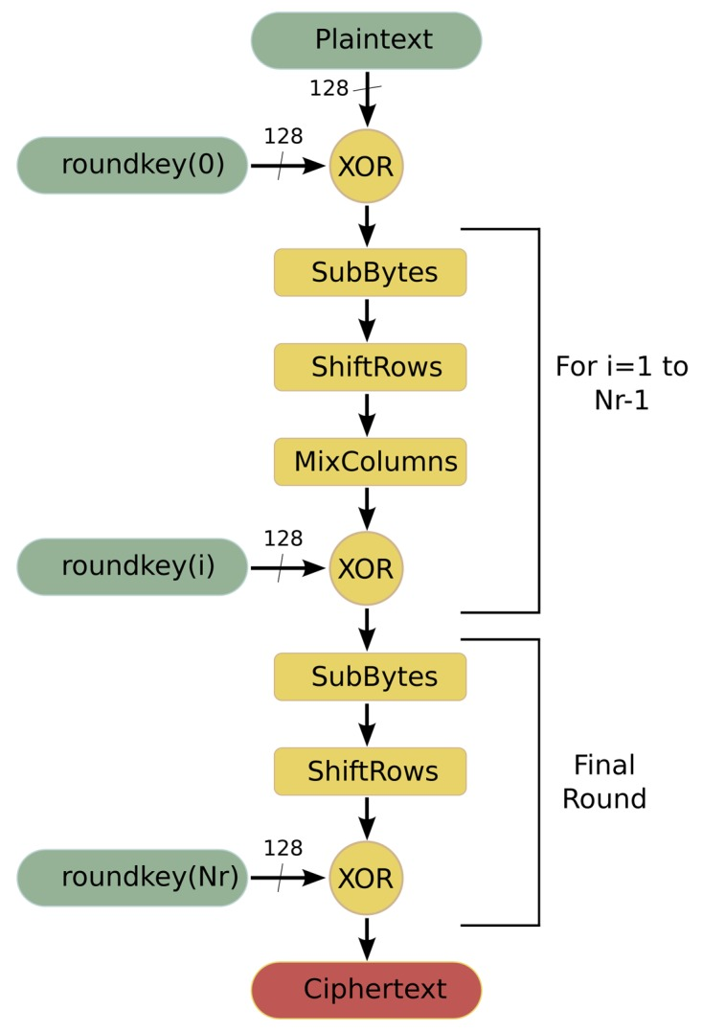
Flow Chart of the AES(encryption)

Slide 4
Major Challenges faced:-
Due to the ongoing global pandemic COVID-19 we had to face a lot of issues for making this project.
Because of colleges shutdown in the global pandemic a proper knowledge of Verilog could not be imparted to us due to which it was quite difficult for us to work on this project.
Despite this being a group project it was difficult to work in a group and contribute equally to the project for all group members because of the ongoing global pandemic.

Slide 5
Simulation Results:-
S.No | Input Text | Cipher Text
1 | 128’hdda97ca4864cdfe06eaf70a0ec0d7191 | 128’hef0bc156ed8ff21223f247b3e0318a99
2 | 128’h3243f6a8885a308d313198a2e0370731 | 128’hf91914cd01924b124c2ec316b4b35a79
3 | 128’h00112233445566778899aabbccddeeff | 128’h8df4e9aac5c7573a27d8d055d6e4d64b
4 | 128’h8ea2b7ca516745bfeafc49904b496089 | 128’hec8ce641087165a463d4118dc35f9001
Key used in above simulations: 128’h2b7e151628aed2a7abf7158809cf4f3c
AES block length=128 bits
Key length=128 bits
No of rounds=10
The correctness of the Verilog model was tested using simulation in ModelSim.

Slide 6


Summary:-
AES is a symmetric block cipher encryption that receives 128-bit size for each block and the size of key is 128, 192, and 256 bits.
AES procedure involves some encryption rounds (Nr), which are determined by the cipher key size.
The mentioned standard uses 10 rounds in AES-128, 12 rounds in AES-192, and 14 rounds in AES-256.
Through encryption, every round is collected(except the last round which does not has MixColumn) as a set of four main transformations –
SubByte Transformation,
ShiftRows Transformation,
MixColumns Transformation
AddRound Key.
After the above round our plain text is converted into a cipher text which is a much more secure form of electronic data.

